Slide 1

Assistive Holder for Disabilities
Team D4
Mohammad Alajmi
Saud Almutairi
Hamad Aldhafeeri
Mahdi Alajmi
Hozhoni Assistive Holder
Nov 7th,2017
1

Slide 2

*Project Description
Main Idea :
Making a device that has many ways to use.
People with disabilities could pick up objects by the assistive holder.
The device can be used by one hand.
Sponsor :
Hozhoni Art
Client :
Terri Engel
Hozhoni Assistive Holder
Nov 7th,2017
Saud
2

Slide 3
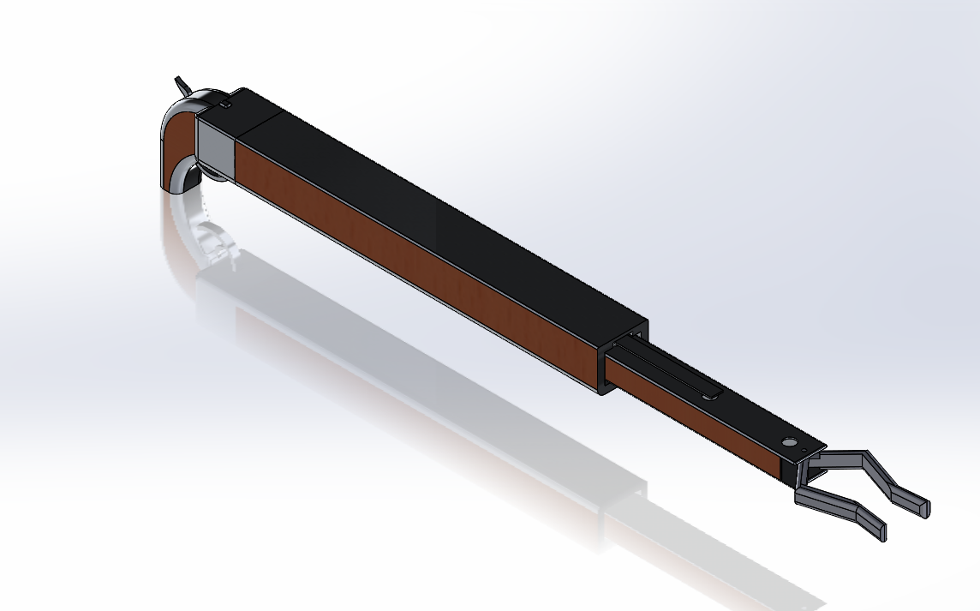
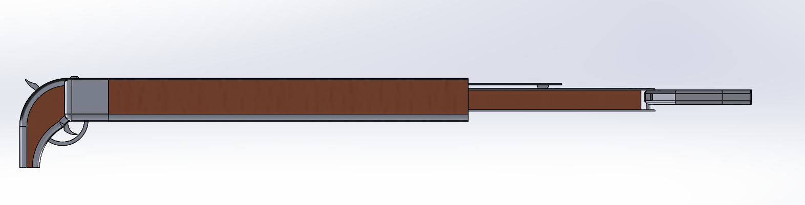
*Designs Description:1
Outer Shaft
Inter Shaft
Grabber Teeth
Handle
Front View
Lock button
Extender button
Flat bar
50 cm
30 cm
Trigger
Side View
Hozhoni Assistive Holder
Nov 7th,2017
Mahdi
3

Slide 4
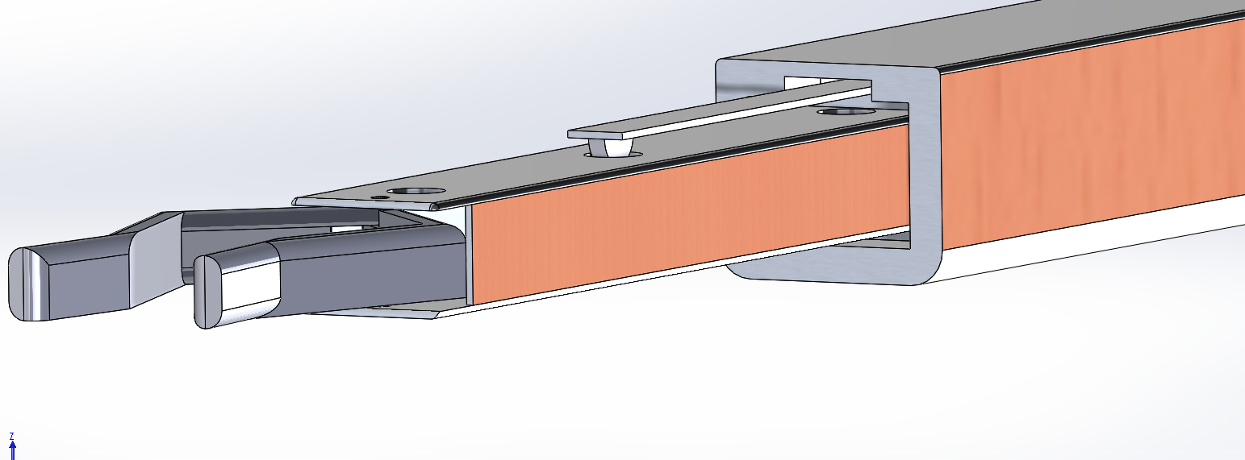
*Designs Description:2
3 holes on
The inter shaft
Hozhoni Assistive Holder
Nov 7th,2017
Mahdi 4

Slide 5
*Design Requirements
Customer Requirements
1. Safety | Edges round to 3 mm
2. Size change | The Length can be change from 50 cm to 80 cm
3. Light weight | The device less than 1 Kg
4. Angle change | The angel of grabber teeth can be 180 degrees
5. Easy to set up | Max 10 parts
6. Easy to use | Can be used with 1 hand
Hozhoni Assistive Holder
Nov 7th,2017
Hamad
5

Slide 6
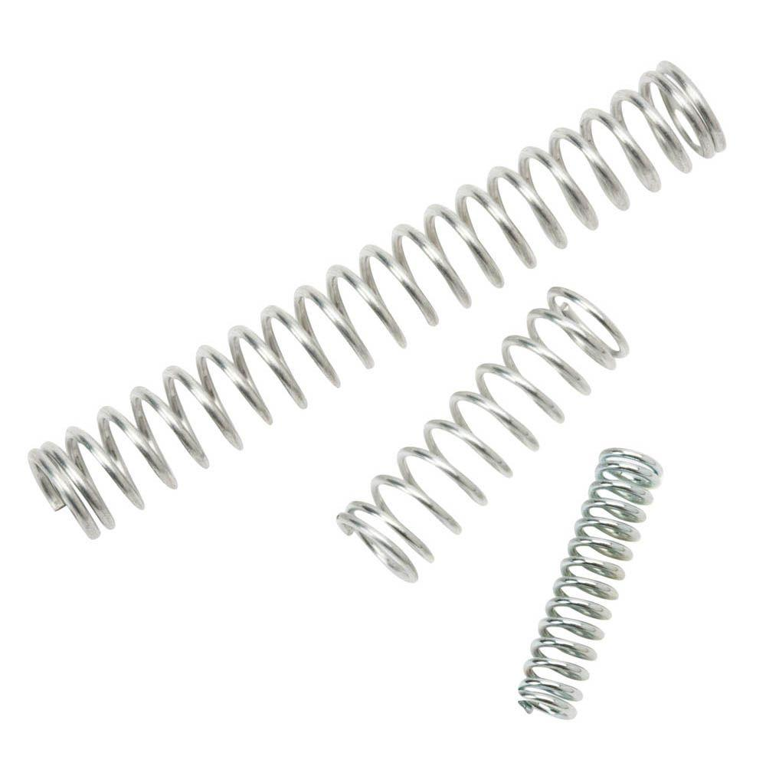
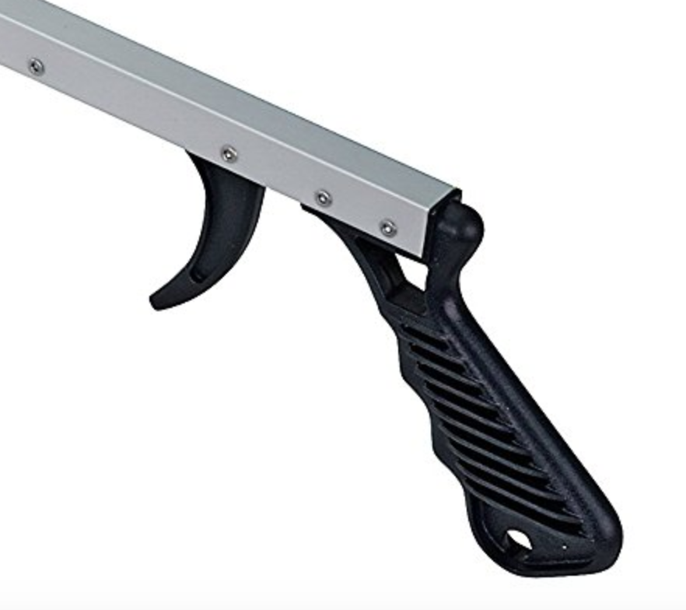
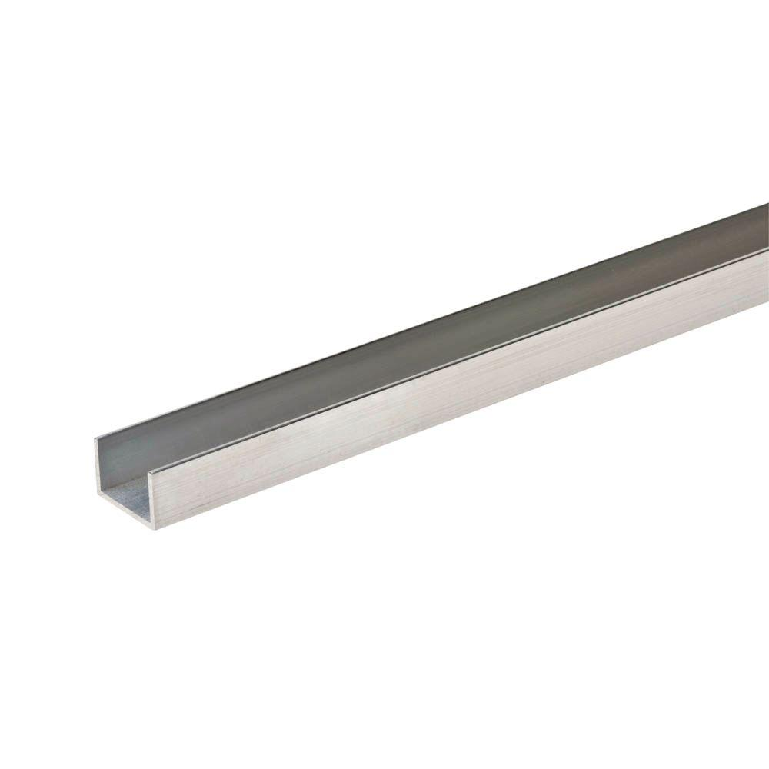
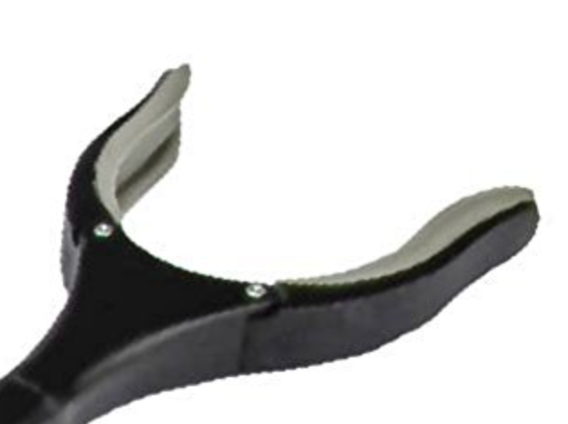
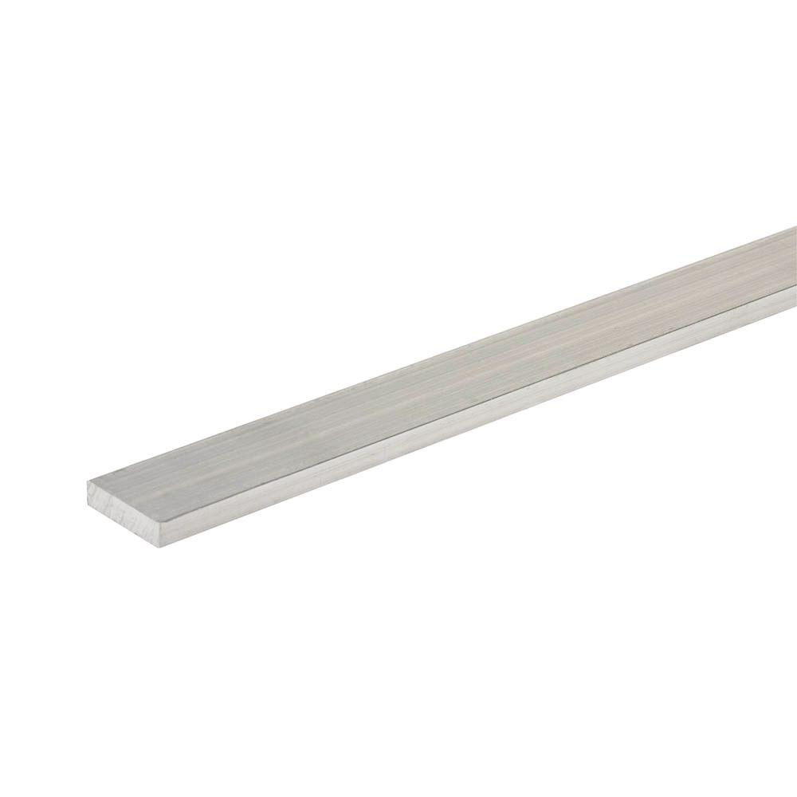
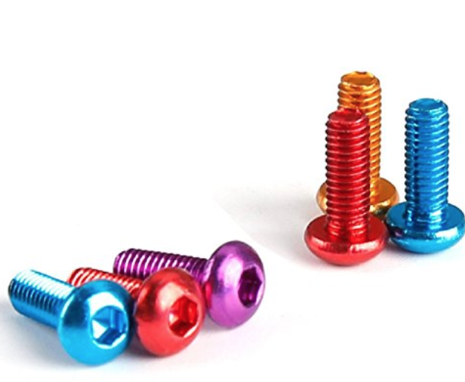
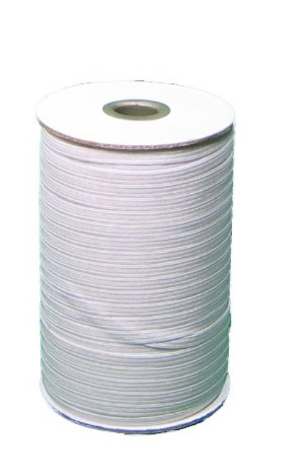
*Bill of Materials
 | Zinc-Plated Compression Spring (6-Pack) with 3 sizes Price ( $3.72 each – Req. 4) [1] |  | Plastic handle with trigger Price ( $8.39 each – Req.1) [2]
 | 1/2 in. W x 1/2 in. H x 96 in. L Aluminum C-Channel with 1/16 in. Thick Price ( $9.39 each- Req. 1) [3] |  | Reacher Grabber by VIVE - Rotating Grip - 32" Extra Long Handy Mobility Aid - Reaching Assist Tool for Trash Pick Up, Litter Picker, Garden Nabber, Disabled, Arm Extension. Price ( $14.99 each – Req.1 [4]
 | 3/4 in. x 36 in. Aluminum Flat Bar with 1/8 in. Thick Price ( $4.28 each – Req.1) [5] |  | 10 Pcs M3 8mm Screws 7075 Aerospace Aluminum Alloy Hexagonal M38 SHCS for FPV RC Quadcopter Drone (Blue) Price ($ 6.99 each – Req.2) [6]
 | Rubber Thread Price ($ 10.99 – Req.1) [7]
Hozhoni Assistive Holder
Nov 7th,2017
Mohammad 6

Slide 7
*Budget
Our budget is 2000$
Estimate Cost : 76.9$ + Tax
Remaining Budget: 2000– 76.9 = 1923.1$
This is an estimate budget because we might need to make some parts, do prototype and print the device on 3D printer.
Hozhoni Assistive Holder
Nov 7th,2017
Mohammad
7

Slide 8
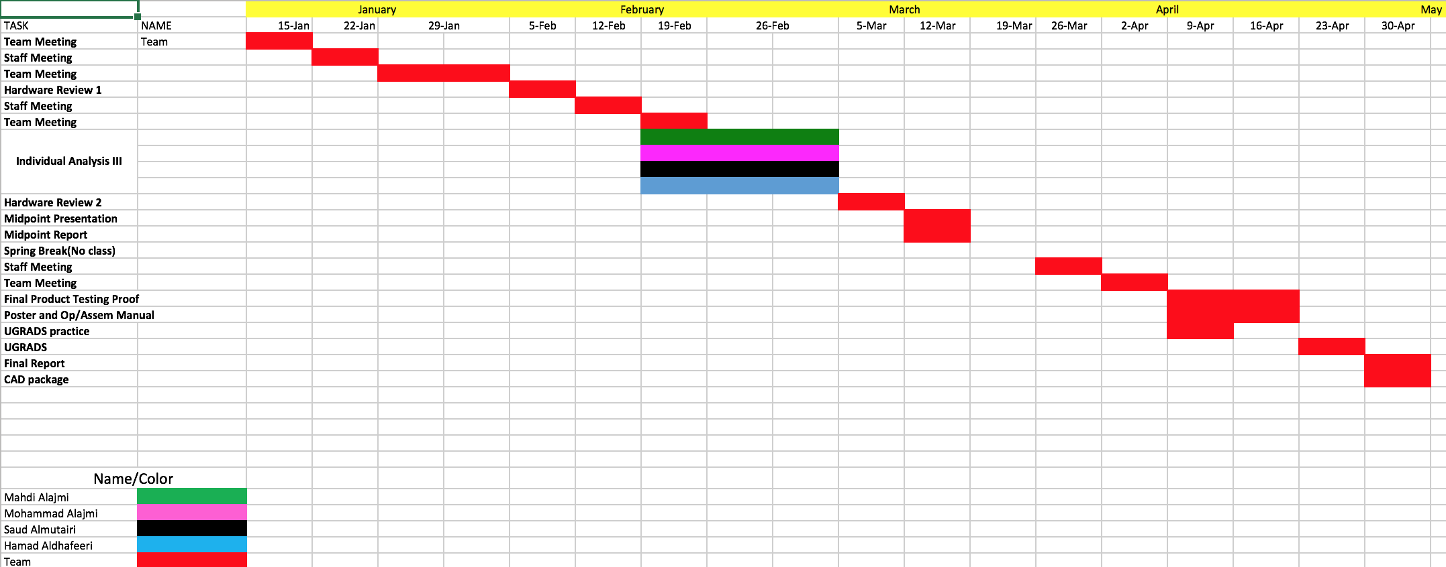
*Schedule for next Semester 1
Hozhoni Assistive Holder
Nov 7th,2017
Mohammad
8

Slide 9
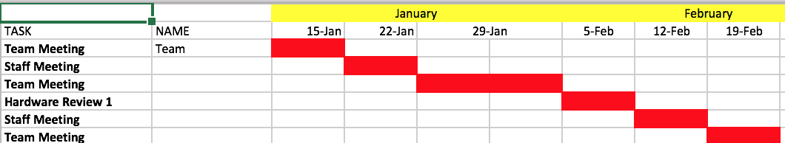
*Schedule for next Semester 2
Hozhoni Assistive Holder
Nov 7th,2017
Mohammad 9

Slide 10
*References
[1]"Everbilt Zinc-Plated Compression Spring (6-Pack)-16087 - The Home Depot", The Home Depot, 2017. [Online]. Available: https://www.homedepot.com/p/Everbilt-Zinc-Plated-Compression-Spring-6-Pack-16087/202045468. [Accessed: 05- Nov- 2017].
[2]2. Kinsman Economy Reacher, "Kinsman Economy Reacher - Our trigger operated reachers are a great option for anyone needing a little extra assistance or those with difficulty bending down. A magnet is embedded added convenience. Choose from our 27'' Reacher or the 32''. 35041, 35043", westcoastmedicalsupply.com, 2017. [Online]. Available: http://www.westcoastmedicalsupply.com/Kinsman_Economy_Reacher_35041_35043_p/3504.htm. [Accessed: 05- Nov- 2017].
[3]"Everbilt 1/2 in. W x 1/2 in. H x 96 in. L Aluminum C-Channel with 1/16 in. Thick-802657 - The Home Depot", The Home Depot, 2017. [Online]. Available: https://www.homedepot.com/p/Everbilt-1-2-in-W-x-1-2-in-H-x-96-in-L-Aluminum-C-Channel-with-1-16-in-Thick-802657/204273938. [Accessed: 05- Nov- 2017].
[4]"Cite a Website - Cite This For Me", Amazon.com, 2017. [Online]. Available: https://www.amazon.com/Reacher-Grabber-VIVE-Rotating-Extension/dp/B00O47NWE6/ref=sr_1_1_sspa?ie=UTF8&qid=1509856120&sr=8-1-spons&keywords=grabber&psc=1. [Accessed: 05- Nov- 2017].
[5]"Everbilt 3/4 in. x 36 in. Aluminum Flat Bar with 1/8 in. Thick-801947 - The Home Depot", The Home Depot, 2017. [Online]. Available: https://www.homedepot.com/p/Everbilt-3-4-in-x-36-in-Aluminum-Flat-Bar-with-1-8-in-Thick-801947/204273954. [Accessed: 05- Nov- 2017].
[6]"Cite a Website - Cite This For Me", Amazon.com, 2017. [Online]. Available: https://www.amazon.com/Screws-Aerospace-Aluminum-Hexagonal-Quadcopter/dp/B0723BNRMB/ref=sr_1_20?s=hi&ie=UTF8&qid=1509853012&sr=1-20&keywords=screws%2Baluminum&th=1. [Accessed: 05- Nov- 2017].
[7]"Cite a Website - Cite This For Me", Amazon.com, 2017. [Online]. Available: https://www.amazon.com/Braided-Elastic-Wide-144-Yards-White/dp/B001S5AN12/ref=sr_1_48?ie=UTF8&qid=1509853560&sr=8-48&keywords=rubber+thread. [Accessed: 05- Nov- 2017].
Hozhoni Assistive Holder
Nov 7th,2017
10

Slide 11
Thank You
Questions?
Hozhoni Assistive Holder
11
Nov 7th,2017

